Slide 1

A Guide to Phonics:
Supporting Children to Learn to Read
The Mosley Academy

Slide 2
What is Phonics?
Phonics is considered to be one of the most secure and best evidenced methods for teaching children to learn to read.
Learning to read is based on 2 dimensions:
Word Reading Language Comprehension
Talk
Development of vocab + language
Fiction, non-fiction, poems, rhyme
Reading for pleasure
Decoding print
Letter-sound correspondences
Tricky words

Slide 3
Terminology
Phoneme: The smallest unit of sound.
Grapheme:A letter or group of letters that represent a single sound.
Digraph:2 letters that make 1 sound e.g. ‘ai’ in ‘rain.’
Trigraph:3 letters that make 1 sound e.g. ‘igh’ in ‘night.’
Blending:Merging sounds together to read a word e.g. ‘c-a-t’ = ‘cat.’
Segmenting:Breaking up the sounds in words for spelling e.g. ‘pot’ = ‘p-o-t.’
Decoding:Recognising the letters and saying each sound in turn for blending.
Encoding:Identifying the sounds in the words e.g. ‘pot’ = ‘p-o-t.’

Slide 4
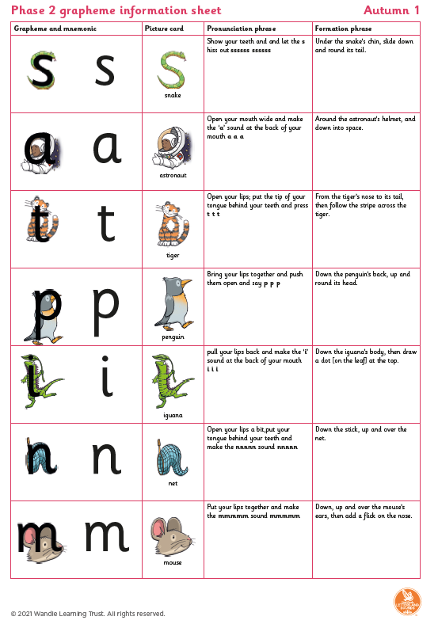
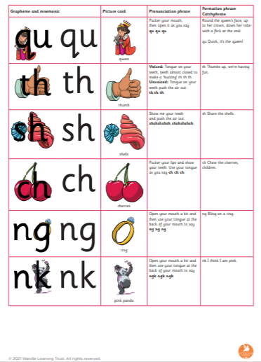
Little Wandle: Letters and Sounds Revised
Our new scheme this academic year!
Carefully sequenced phonics
learning, with accompanying
visuals and mnemonics.
Group reading practise sessions
3x week with books carefully
matched to your child’s phonic
knowledge.

Slide 5
Phases
Phonics can be divided into 5 key phases:
Phase 1 – Nursery/Recap in Reception
Phase 2 – Reception
Phase 3 – Reception
Phase 4 – Reception + Y1
Phase 5 – Y1/Recap in Y2

Slide 6
Phase 1
Typically taught in Nursery.
Focuses on pre-phonics skills:
Sound discrimination Rhyme
Initial sounds
Body percussion
Alliteration

Slide 7
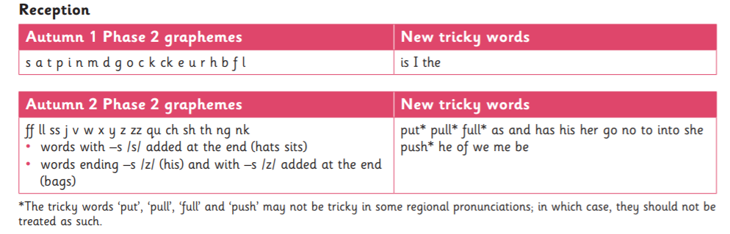
Phase 2
Taught in Reception.
Pronunciation is vital! E.g. ‘m’ as pure sound not ‘muh.’ More information on pronunciation can be found here:
https://youtu.be/shlSQrleibs
Tricky words (also known as common exception words).
Encourage correct letter formation using the visuals and mnemonics relating to each sound.

Slide 8
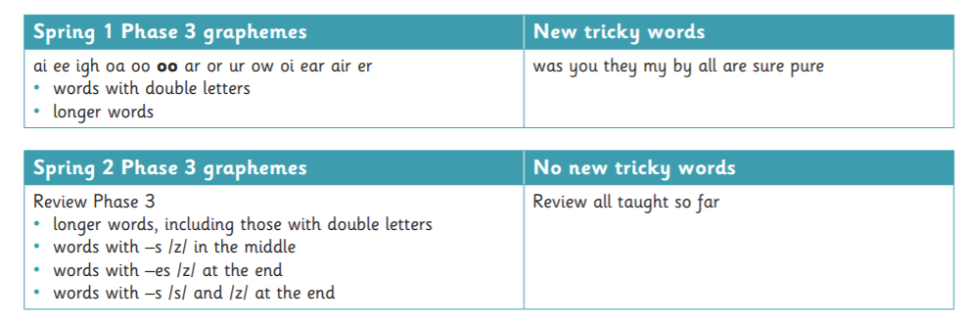
Phase 3
Taught in Reception.
Again, pronunciation is vital! More information here:
https://youtu.be/tKUEQFXXfYY
https://youtu.be/wxRMoHynvy0
Introduce digraphs and trigraphs.

Slide 9
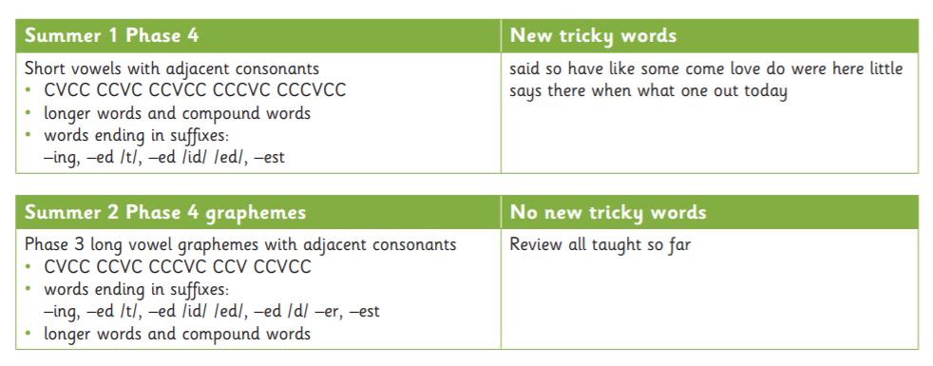
Phase 4
Taught in Reception and revisited in Year One.

Slide 10
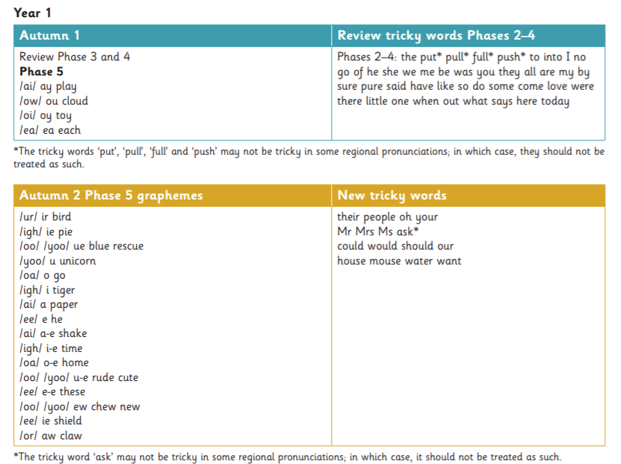
Phase 5
New digraphs and trigraphs
Alternative spellings e.g. ‘ai’ sound can be written as…
‘ai’ in ‘rain’, ‘a’ in ‘acorn’ ‘ay’ in ‘play’ ‘eigh’ in ‘eight’ ‘a-e’ in ‘cave’ etc
Alternative pronunciations e.g. ‘ow’ in ‘cow’ but ‘ow’ in ‘blow.’

Slide 11
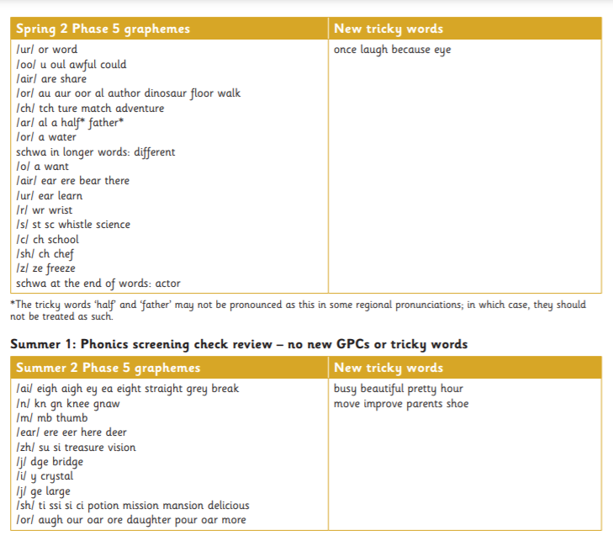
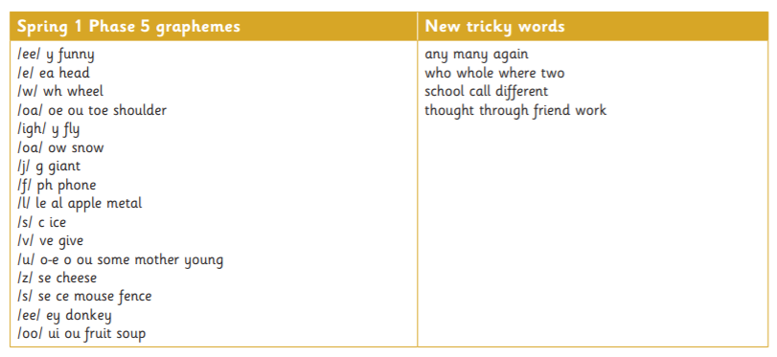
Phase 5

Slide 12

Phonics Screening Check
In the Summer term of Year One, children will take part in the statutory ‘Phonics Screening Check.’ This is a short assessment whereby children sit 1:1 with their teacher to read a selection of 40 real or nonsense (pseudo) words.
The assessment will include words that
have a range of the sounds, across phases,
That children have learnt in Reception and
Year One.
The Phonics screening check aims to
identify whether children have learnt sufficient
phonic decoding and blending skills.
Your child’s performance in the phonics screening
check will be reported to you. If your child does not
pass the screening check, additional support will be provided
to support them to develop their phonics and reading skills.

Slide 13
Chocolate Buttons and Chocolate Fingers!
While children learn to read words, we identify individual sounds using ‘sound buttons’ and ‘sound bars.’ At Mosley, we call these ‘chocolate buttons’ and ‘chocolate fingers’!
E.g.
jet airport
ship

Slide 14
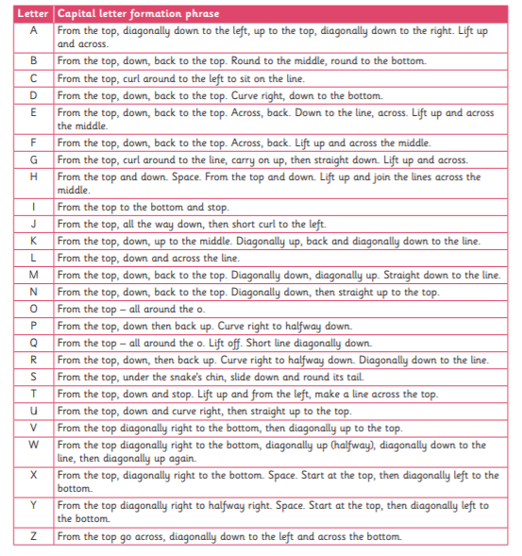
Capital Letters

Slide 15
Help at Home
Talk! Regularly introduce new words e.g. rather than saying ‘Wow you have built a big tower!’ consider swapping to ‘huge’ ‘enormous’ ‘large’ to develop their word bank
Make it fun – robot talk, treasure hunt, sound hunt, hit the targetfor new sounds (e.g. with a football, water gun)
Read daily
If your child is struggling to decode a word, use your finger to signal ‘chocolate buttons’ or ‘chocolate fingers’
Discuss the meaning of new words, have fun with new vocabulary
Sing nursery rhymes and songs together

Slide 16
Useful Websites
Tips, advice and videos directly from ‘Little Wandle’:
https://www.littlewandlelettersandsounds.org.uk/resources/for-parents/
PhonicsPlay – explore interactive games to apply your phonic knowledge:
https://www.phonicsplay.co.uk/
Phonics Bloom – explore interactive games to apply your phonic knowledge:
https://www.phonicsbloom.com/

