Slide 1

Year 4 Multiplication Tables Check
Presentation for Parents, Carers & Guardians
2021

Slide 2
What is the purpose of the multiplication tables check?
To determine whether year 4 pupils can fluently recall their multiplication tables up to 12x12 which is essential for future success in mathematics.
To help schools to identify pupils who require additional support with their multiplication tables.
The DfE will create a report on overall results across all schools in England to measure progress and improvements.

Slide 3
When the multiplication tables check will be carried out
There will be 3-week window in June for the administration of the check.
There is no set day to administer the check.
Teachers will make decisions as to when the checks are carried out with children, within the given 3-week window in June.
Children are not expected to take the check at the same time.
This is a statutory assessment and all eligible children in England are required to partake, in the same manner as they would for KS1 and KS2 National Testing (SATs)

Slide 4
How the multiplication tables check is carried out
The check will be fully digital and take place on screen. At Mosley, this will more than likely be on Ipads.
However, children will also have the option to use laptops and desktops.
Answers will be entered using a keyboard or by pressing digits on a touchscreen, using an on-screen number pad. In cases where children have chosen to use laptops and desktops, answers will be entered using a mouse or touchpad.

Slide 5
How the multiplication tables check is carried out
Under standard administration the multiplication check will take less than 5 minutes per pupil.
Children will get 6 seconds from the time the question appears to input their answer AND press ‘enter’.
There will be 25 questions with a 3 second pause in-between questions.

Slide 6
The questions
Each pupil will be randomly assigned a set of questions.
There will be repeated questions across different checks each year, but no more than 30% of questions will be repeated in any two checks.
Children will only face multiplication statements in the check, not related division facts.
Pupils will not be able to see their individual results when they complete the check.

Slide 7
During the check
There will always be questions from the 3, 4, 5, 6, 7, 8, 9, 11 and 12 multiplication tables in each check.
There will be no questions from the 1 times table (i.e 1 x 8 or 8 x 1).
The 6, 7, 8, 9 and 12 times tables are more likely to be asked.
There will only be a maximum of 7 questions from the 2, 5 and 10 times tables.
Reversal of questions will not feature in the same check.

Slide 8

Multiplication table limits
The multiplication tables are classified by the first number in the question.
For example, 8 x 3 = would fall within the 8 times table.

Slide 9
Questions more likely to appear
The following 11 multiplication questions are more likely to be asked:
  6 x 6, 6 x 7, 6 x 8, 6 x 9, 6 x 12
  7 x 8, 7 x 9, 7 x 12
  8 x 9, 8 x 12
  12 x 12

Slide 10
Before the check
Children can practise before taking the check
There will be a ‘try it out’ area the children can use to become familiar with the timings and layout of the check.
On the run up to the 3 week assessment window opening in June, children will be able to take a ‘mock’ version of the MTC and teachers will use this to alleviate any anxieties / concerns children may have and familiarise the children with the structure of the assessment and ‘look and feel’ of the MTC platform.
Teachers may decide NOT to tell children exactly when they are about to undertake the REAL assessment so as to avoid unnecessary apprehensions.

Slide 11
How the school teaches times tables so pupils learn instant recall
Teaching times tables facts first:
Counting and looking for patterns
Repeated addition
Multiplication is commutative
Multiplication is the inverse of division
Number families
(The following slides will go into each of these teaching strategies in more detail for your information.)
Use of different representations:
Concrete manipulatives such as counters or multilink cubes
Pictorial representations such as arrays

Slide 12
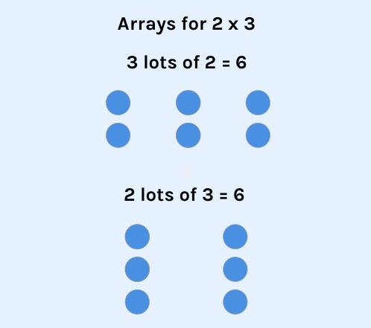
Multiplication is commutative
(can be completed in any order to produce the same answer)
3 x 2 is the same as 2 x 3.
Children need to understand that multiplication can be completed in any order to produce the same answer. Sometimes this link needs to be made explicit.

Slide 13
Multiplication is the inverse of division
20 ÷ 5 = 4 can be worked out because 5 x 4 = 20.
Using pictorial representations (such as arrays) is useful here for children to see the link between multiplication and division.

Slide 14
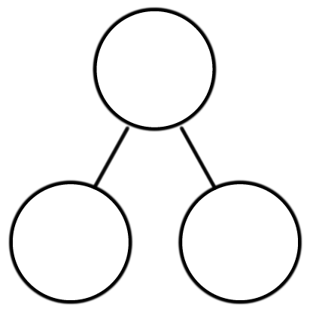
Number families
4 x 5 = 20, 5 x 4 = 20, 20 ÷ 5 = 4, 20 ÷ 4 = 5
Due to their commutative understanding, children should also be able to see whole number families. For many children this will need to be pointed out and discussed.
20
4
5

Slide 15
Using known facts
7 x 12 = ?
I know 7 x 11 = 77
Therefore, 77 + 7 = 84
By using known facts from ‘easier’ times tables, children should be able to find answers with increasing speed.

Slide 16
Example multiplication table check
This website will give you an idea of the speed at which children will be asked questions.
https://mathsframe.co.uk/en/resources/resource/477/Multiplication-Tables-Check
On this resource, you will be able to download your child’s results and analyse the questions answered correctly / incorrectly.
On Times Table Rockstars, the ‘Soundcheck’ game option also closely mimics the MTC.

Slide 17
How can I support my child in preparing for their multiplication tables check?
Firstly, a positive attitude goes a long way – so as much encouragement and support as possible.
Some further tips:
Make times tables fun;
  Climb stairs counting in multiples
  Play verbal times tables games
  Listen to and learn times tables songs
  Play online maths games
  Ensure TTRS / Times Table Test practice homework is completed every week
Talk directly to your child’s class teacher if you have any worries (try not do so away from your child so as not to worry them);
Encourage your child to talk to yourself, their teacher or another adult they trust if they express persisting anxieties about the check. Remember that a small amount of anxiety is normal and not harmful and teachers will work very hard to make the MTC as seamless a process as possible.

Slide 18
Remember this about the multiplication tables check
The check will focus on what they know about times tables only.
It won’t reflect their understanding of wider mathematical topics.
The check is only 5 minutes long
For most children, the check will last for a maximum of 5 minutes. When they have finished, they will not need to repeat the check.

