Slide 1

Year 5 Residential to Whitemoor Lakes
Wednesday 10th – Friday 12th December 2025

Slide 2
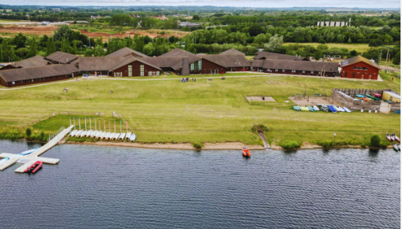
Whitemoor Lakes
Dates: Wednesday 10th December to Friday 12th December
Destination: Whitemoor Lakes Activity Centre
Accommodation: Buttermere Lodge
Who: Year 5 – Miss Luce, Mrs Marriott, Mrs Insley and Mrs Kirkman
Purpose: to have a fun, educational, festive break; team building, festive celebrations, outdoor activities!

Slide 3
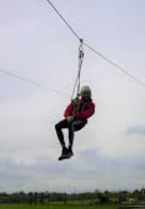
What do they learn?
Independence​
Personal Organisation​
New skills and activities​
Teamwork​
Self-reliance​
Self-belief​
Determination and resilience​
An appreciation of home!​
They have AMAZING fun – creating many wonderful memories!

Slide 4


Slide 5
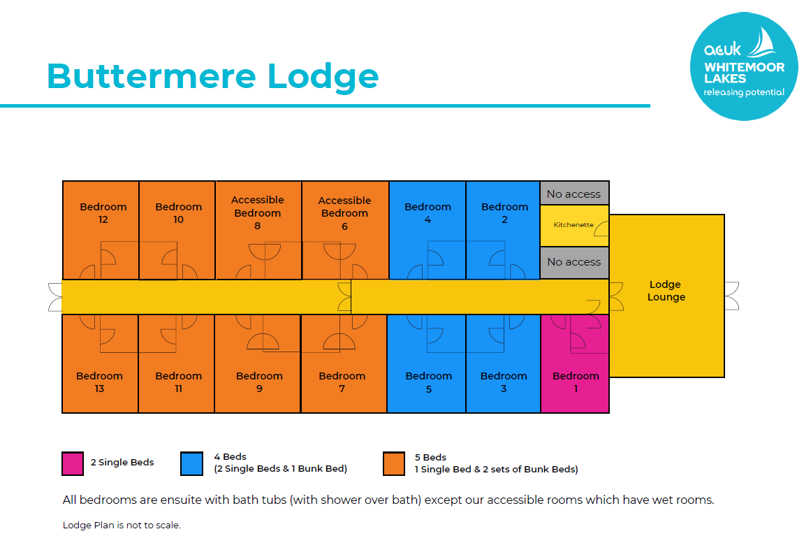
Dorms:
Groupings for dorms will be decided by Miss Luce and Mrs Rowe
Dorm etiquette:​
No food​
No electronic devices​
Keep your clothing and equipment tidy​
No waking anyone else up!
Dorm inspections:​
*Every morning by Camp Lead Instructor – ‘Best Kept Dorm’ awards/points given every day

Slide 6
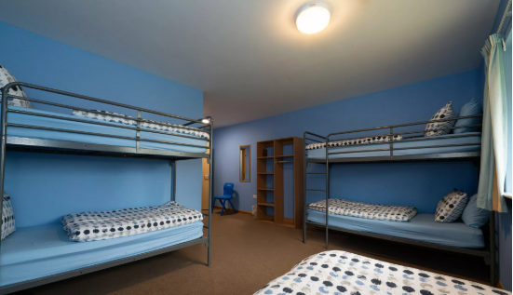
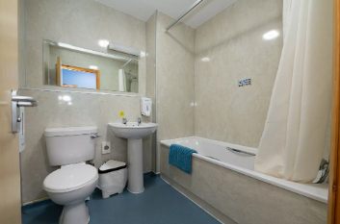
Dorms

Slide 7
Overnight Arrangements
Whitemoor Lakes is a secure site that always has a first aid trained member of their staff on site when​ there are groups staying overnight.​​
Centre staff will always make sure school staff and children know where to find them in case they are needed during the night.​
Dorms are arranged as per the picture on the previous slide. School staff will be placed at regular points for children to access.​
Staff will ensure children are safely tucked up in their dorms and will remain awake until all​children are asleep, conducting regular perimeter checks.​
Children must NOT leave their dorm unless there is an emergency.
Children are to remain in their dorms until a school staff member wakes them.

Slide 8
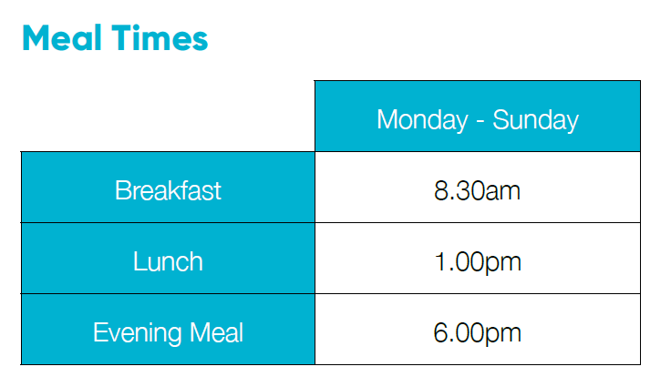
Mealtimes and Medical
Please ensure that you complete the medical form so that we have all information we require.
We will take any medication with us in a designated box – labelled and with record sheets.
Menus are available around 3 weeks in advance of our trip, but a sample menu is on the following slide.

Slide 9
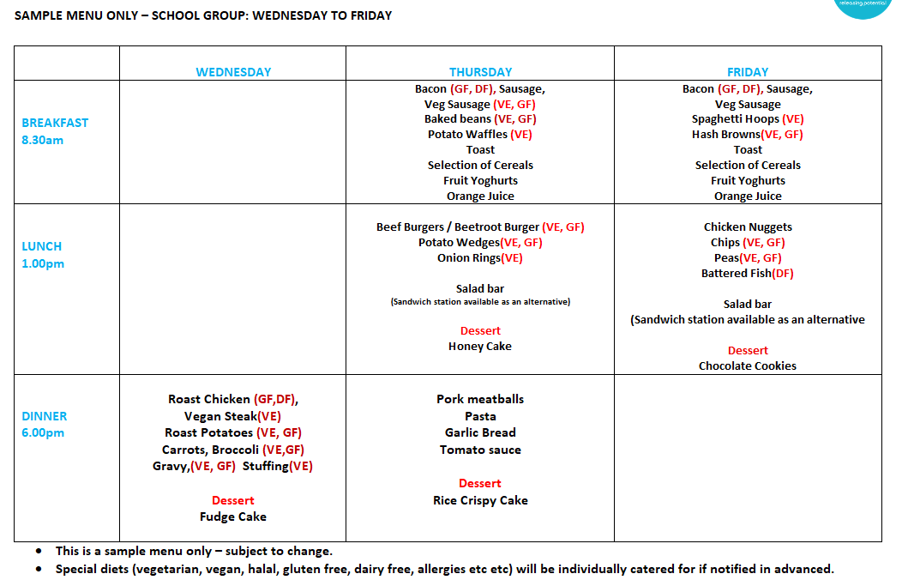

Slide 10
First Aid and Medication
All centre staff and school staff in attendance are first aid trained
*In the event of an emergency, lead teachers will contact Mrs Rowe / Mrs Carlton at school and school will contact parents/carers accordingly
*If your child suffers from hay fever, asthma, epilepsy, or diabetes, it is essential that medication, including inhalers etc., is brought, even though it may not be required.
*Please ensure all medication that your child may require during their visit is clearly labelled with the their name and dosage required.
* We will require you to hand medication to school staff on the morning of the residential trip
If inhalers are required please check they are full, in date and provide us with a spare.
If Epipens or similar are required please ensure 2 are supplied
If your child is not confident in taking medication please let school staff know
All parents/carers are required to complete the ‘Medical Information and Consent’ form which will be sent home with children. These are also available on request from the school office
Please return the medical form on Friday INSERT DATE latest so that the information is as up to date as possible

Slide 11
Contact
School staff will contact school to advise that children have arrived safely at Laches Wood. School will then notify parents/carers via MCAS of this.
*The lead teacher(s) will contact Mrs Rowe / Mrs Carlton each morning to update school on how the children are doing. School will then notify parents/carers via MCAS of this
*There is no need for your child to have a phone with them. If a phone is found, this will be taken and kept safe by school staff member(s)
*In the event of an emergency, lead teacher(s) will inform school and school will telephone parents/carers immediately
*If an incident of serious or continuous poor behaviour occurs, school will be contacted and Mrs Rowe/Mrs Carlton will call parents/carers requesting they collect their child from Laches Wood
School staff will contact school to advise when children are leaving Whitemoor Lakes. School will then notify parents/carers via of this so you can come to collect your child from school early
In the unlikely event that you need to contact your child in case of an emergency / unforeseen situation, please telephone school and Mrs Rowe / Mrs Carlton will make contact with the lead teacher(s) accordingly

Slide 12
Souvenir Shop / Pocket Money:
Whitemoor Lakes has a souvenir shop that opens on the last day.​​
They have a great range of souvenirs that children may buy to take home.​
Children may bring a small NAMED purse/wallet with them but please do not bring any more than £10.​
Small change is advised where possible please.​
Purses / wallets will be collected on the morning of the residential trip, by school staff, and kept by school staff throughout the week. Staff will hand the purses/wallets out on the last day, when the shop opens.

Slide 13
Behaviour Expectations
*You are representing The Mosley Academy and yourself as a Year 5 role model.
* If you choose to misbehave / break any of the site rules, the following consequences will be applied by centre and school staff, as they deem appropriate:
Removal of treat/privileges such as free time/tuckshop
Removal from the activity or from the next activity
If you choose to behave poorly at or after bedtime, you will sit with staff until the rest of the children in your dorm are asleep. You will then be returned to your dorm by a staff member to go straight to sleep.
In cases of persistent or serious poor behaviour, your parents will be contacted and we will ask for you to
be collected and taken home immediately
  All attending children are required to adhere to behaviour code of conduct.
  Please remember, school staff members are ‘on duty’ with you 24 hours a day and are giving up their time away from their own families to take you to Whitemoor Lakes; please treat them with respect and kindness throughout the week, just as you would in school

Slide 14
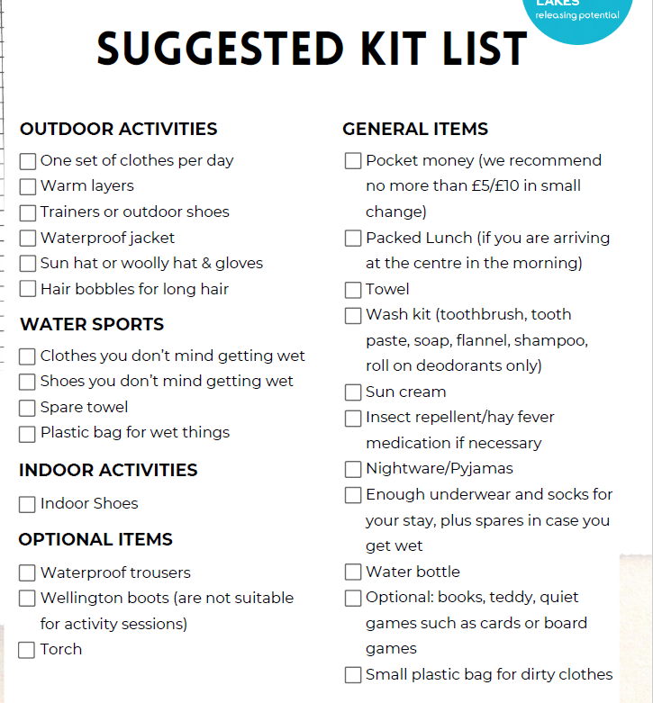
Clothing and Equipment:
Make sure children know what they have packed!
Pack old clothes that you do not mind getting muddy.
For water sport activities please bring a pair of old trainers which you do not mind getting wet.
NO ELECTRONIC DEVICES / PHONES ALLOWED.
Staff members will not be held responsible for any damage to or loss of equipment or clothing; children are responsible for their own belongings.
A ‘kit list’ will be made available to you.
PLEASE NAME EVERYTHING!
Children must be able to carry their own bag AND fit it inside their dorm – avoid huge suitcases!

Slide 15
Any questions?
Please don’t hesitate to ask!
Email
Message through your child.

Slide 16


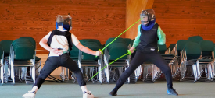
Have the best time!

