Slide 1
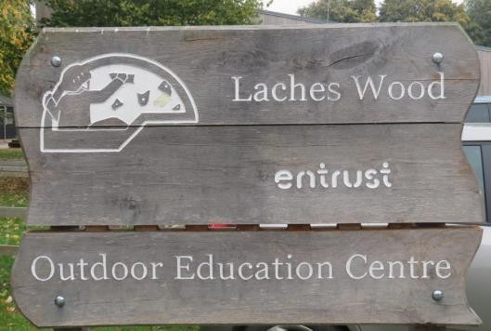
YEAR 6 RESIDENTIAL TO LACHES WOOD
Tuesday 7th-Friday 10th October 2025

Slide 2
Laches Wood 2025
Why Laches Wood:
Laches Wood has a rich mix of natural beauty and woodland shelter, as well as indoor and outdoor adventure.
At Laches Wood, there is a wide range of year-round adventure activities including high ropes, bike trails and indoor climbing and caving.
Entrust Outdoors has a sixty-year pedigree of providing high quality outdoor education for children, young people and adults, with the skills and expertise to deliver a wide range of outcome focused activities.
They encourage all visitors to embrace their ‘Explore and Inspire’ theme and follow their own path of discovery and adventure.
All activities are led by highly qualified, passionate, and active outdoor practitioners with great experience and some of this country’s leading professional awards and training.
Mosley Staff in attendance:
Mrs Day, Mrs Ingham, Mrs Rowe, Mrs Sandars, Mrs Insley
  Location:
  Wolverhampton. Approximately 45 minutes from school

Slide 3
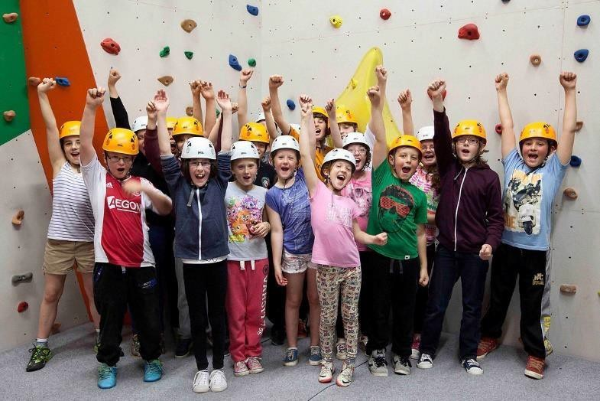
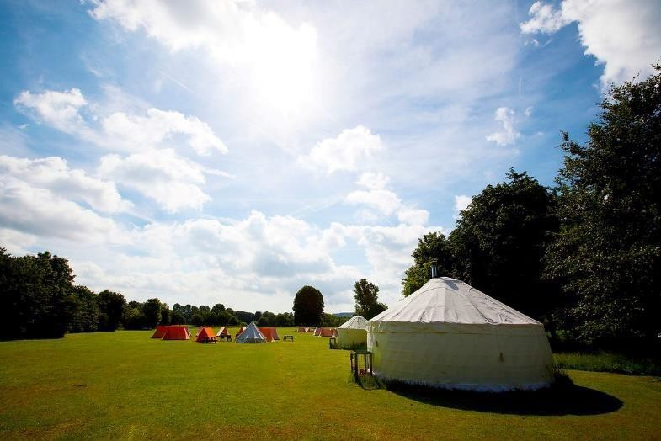
What do they learn?
Independence
Personal Organisation
New skills and activities
Teamwork
Self-reliance
Self-belief
Determination and resilience
An appreciation of home!
They have AMAZING fun – creating many wonderful memories!
https://youtu.be/xRXPOS8Ilrc?list=TLGGObZVS-5t9Q0wNzA2MjAyMg

Slide 4
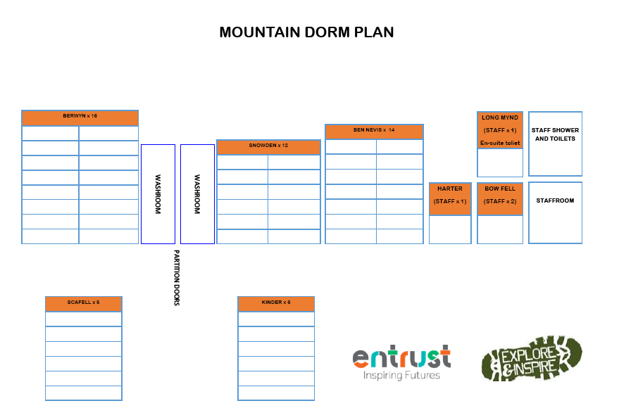
Dorms: Mountain Block
Groupings of approx. approx. 6:
  Decided by Mrs Claxton, Mrs Day and Mrs Rowe
Dorm etiquette:
  No food
  No electronic devices
  Keep your clothing and equipment tidy
Dorm inspections:
*Every morning by Camp Lead Instructor – ‘Best Kept Dorm’ awards/points given every day

Slide 5
Overnight Arrangements:
Laches Wood is a secure site that always has a first aid trained member of their staff on site when
there are groups staying overnight.
Centre staff will always make sure school staff and children know where to find them in case they are needed during the night.
Dorms are arranged as per the picture on the previous slide. School staff will be placed at regular points for children to access.
Staff will ensure children are safely tucked up in their dorms and will remain awake until all
children are asleep, conducting regular perimeter checks.
Children must NOT leave their dorm unless to go to the toilet, in which case they must make their way to the toilet quietly and sensibly, returning straight away.
Children are to remain in their dorms until a school staff member wakes them.

Slide 6
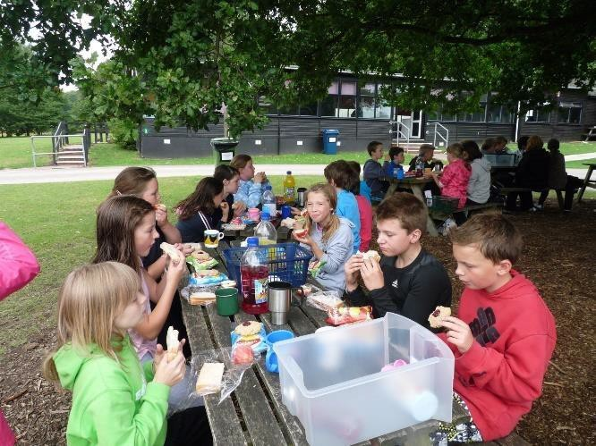
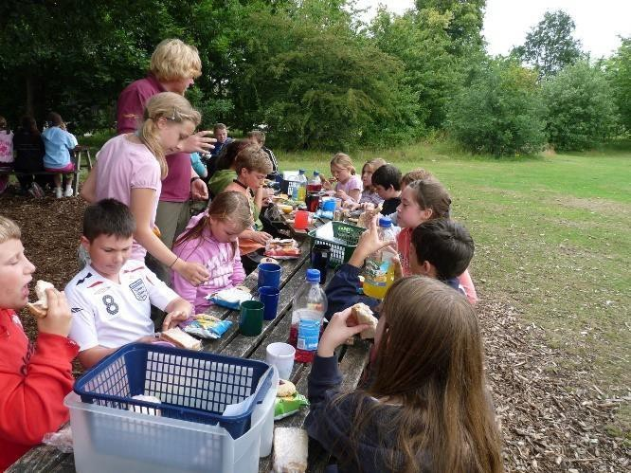
Mealtimes
All Entrust centres are ‘nut free’ and the caterers are highly competent in providing
for a wide range of special dietary requirements and allergen avoidance.
Meal choices will be made upon arrival, and on each of the following days.
Every tap is for drinking water so the children can fill up their water bottle as frequently as they require.
A typical day consists of breakfast, lunch, dinner and evening ‘supper’.
Children will sit at ‘team tables’ and eat with their ‘team’ and the rest of their
school. School staff members will be present throughout.
Laches Wood offers the following menus; main, egg-free, gluten-free, milk-free and vegan.
We will use our school dietary information to inform Laches Wood of the children’s dietary needs, as informed by parents and carers.

Slide 7
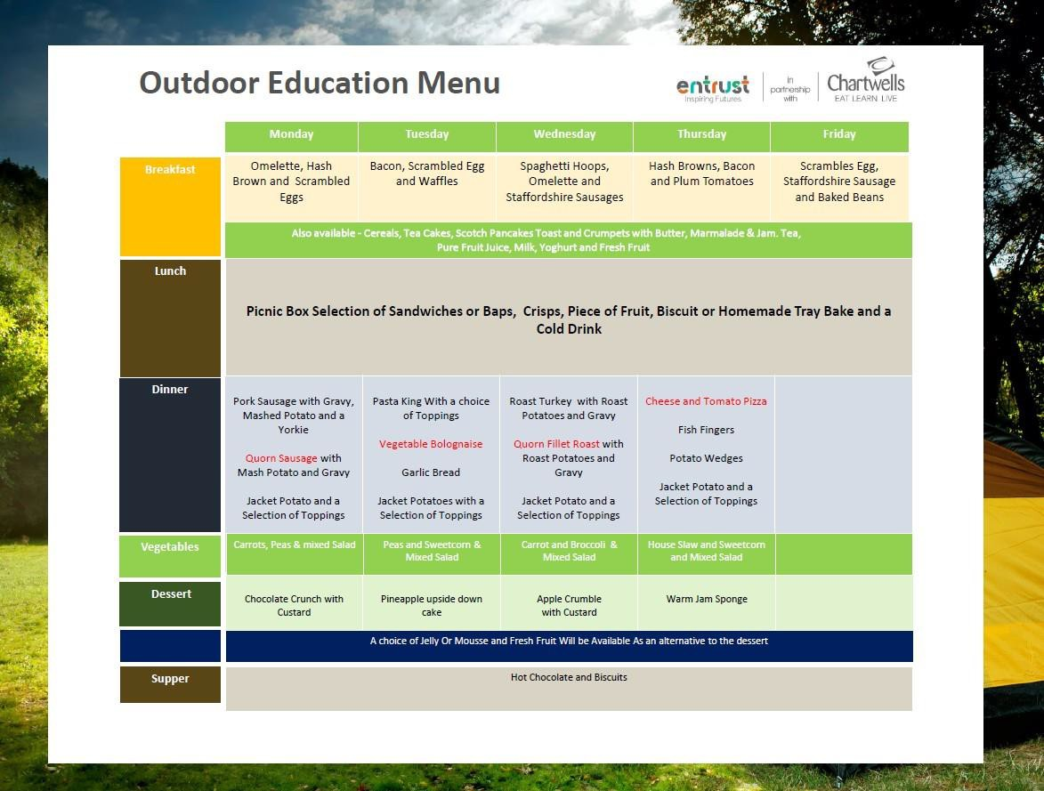


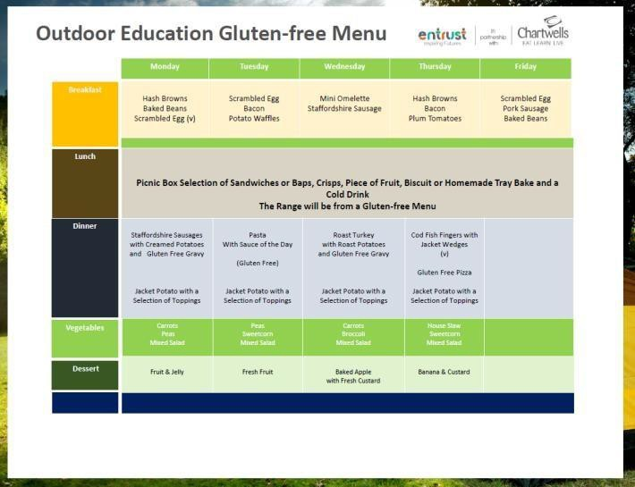

Copies of all menus are available on the school website Outdoor learning page.
Additional copies are available on request from the school office. For any special diets, please talk to the school office and we will pass this on to LACHES wOOD IN ADVANCE.
DO NOT ALLOW CHILDREN TO BRING EXTRA SNACKS –THEY WILL NOT BE NEEDED
AND MAY ATTRACT UNWANTED DORM VISITORS…

Slide 8
Souvenir Shop / Pocket Money:
Laches Wood has a souvenir shop that opens on the last day.
They have a great range of souvenirs that children may buy to take home.
Children may bring a small NAMED purse/wallet with them but please do not bring any more than £10.
Small change is advised where possible please.
Purses / wallets will be collected on the morning of the residential trip, by school staff, and kept by school staff throughout the week. Staff will hand the purses/wallets out on the last day, when the shop opens.

Slide 9

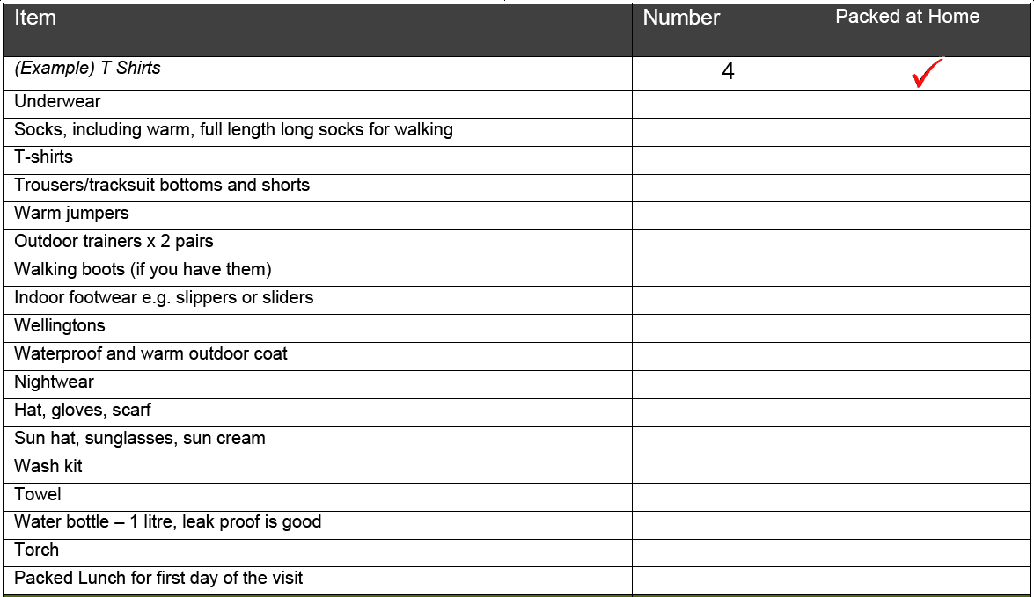
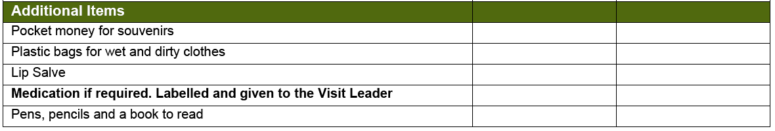
Clothing and Equipment:
Make sure children know what they have packed!
Pack old clothes that you do not mind getting muddy.
For water sport activities please bring a pair of old trainers which you do not mind getting wet.
NO ELECTRONIC DEVICES / PHONES ALLOWED.
Staff members will not be held responsible for any damage to or loss of equipment or clothing; children are responsible for their own belongings.
A ‘kit list’ is available on the school website).
PLEASE NAME EVERYTHING!
Children must be able to carry their own bag AND fit it inside their dorm – avoid huge suitcases!

Slide 10
First Aid and Medication:
All centre staff and school staff in attendance are first aid trained
*In the event of an emergency, lead teachers will contact Mrs Rowe / Mrs Carlton at school and school will contact parents/carers accordingly
*If your child suffers from hay fever, asthma, epilepsy, or diabetes, it is essential that medication, including inhalers etc., is brought, even though it may not be required.
*Please ensure all medication that your child may require during their visit is clearly labelled with the their name and dosage required.
* We will require you to hand medication to school staff on the morning of the residential trip
If inhalers are required please check they are full, in date and provide us with a spare.
If Epipens or similar are required please ensure 2 are supplied
If your child is not confident in taking medication please let school staff know
All parents/carers are required to complete the ‘Medical Information and Consent’ form which will be sent home with children. These are also available on request from the school office
Please return the medical form on Friday October 3rd latest so that the information is as up to date as possible

Slide 11
Contact:
School staff will contact school to advise that children have arrived safely at Laches Wood. School will then notify parents/carers via MCAS of this.
*The lead teacher(s) will contact Mrs Rowe / Mrs Carlton each morning to update school on how
the children are doing. School will then notify parents/carers via MCAS of this
*There is no need for your child to have a phone with them. If a phone is found, this will be taken and kept safe by school staff member(s)
*In the event of an emergency, lead teacher(s) will inform school and school will telephone
parents/carers immediately
*If an incident of serious or continuous poor behaviour occurs, school will be contacted and Mrs Rowe/Mrs Carlton will call parents/carers requesting they collect their child from Laches Wood
School staff will contact school to advise when children are leaving Laches Wood. School will then notify parents/carers via of this so you can come to collect your child from school early
In the unlikely event that you need to contact your child in case of an emergency / unforeseen
situation, please telephone school and Mrs Rowe / Mrs Carlton will make contact with the lead teacher(s) accordingly

Slide 12
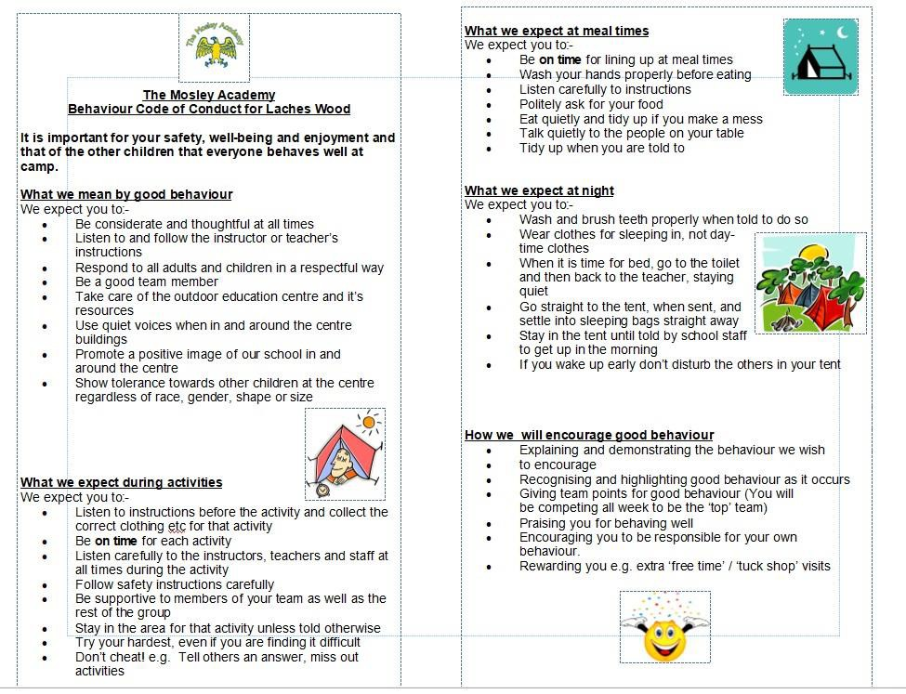
Behaviour Expectations:
*You are representingThe MosleyAcademy and yourself as a year 6 role model.
* If you choose to misbehave / break any of the site rules, the following consequences will be applied by centre and school staff, as they deem appropriate:
Removal of treat/privileges such as free time/tuckshop
Removal from the activity or from the next activity
If you choose to behave poorly at or after bedtime, you will sit with staff until the rest of the children in your dorm are asleep. You will then be returned to your dorm by a staff member to go straight to sleep.
In cases of persistent or serious poor behaviour, your parents will be contacted and we will ask for you to
be collected and taken home immediately
  All attending children are required to adhere to behaviour code of conduct.
  Please remember, school staff members are ‘on duty’ with you 24 hours a day and are giving up their time away from their own families to take you to Laches Wood; please treat them with respect and kindness throughout the week, just as you would in school

Slide 13
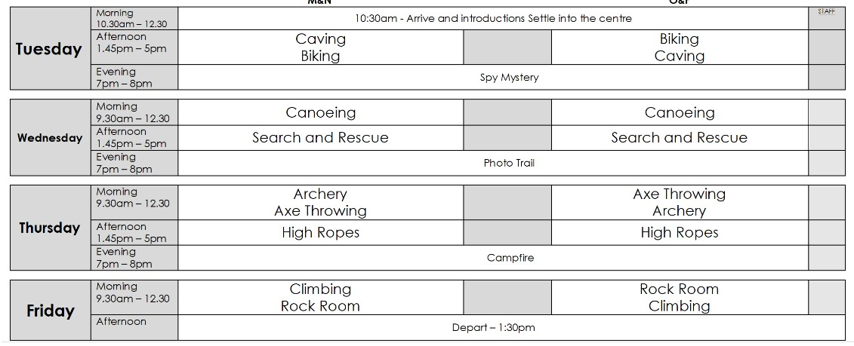
A typical week at Laches Wood:
Activities will be just our school, with Year 6 being split into 4 activity groups – see the website for the updated activity plan.
*Each group will be made up of 2 ‘teams’ and each group will be accompanied to the activities by a member of our staff as well as a centre activity leader
Free time will be spent as a school at set points throughout each day- these will be supervised

Slide 14
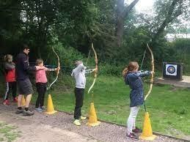
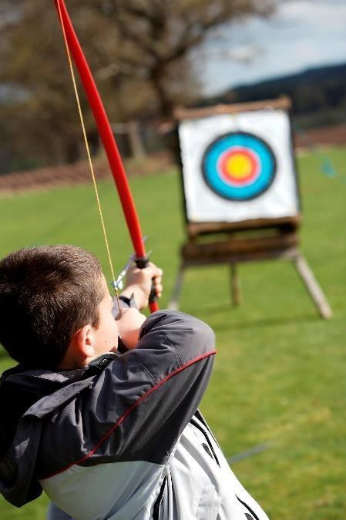
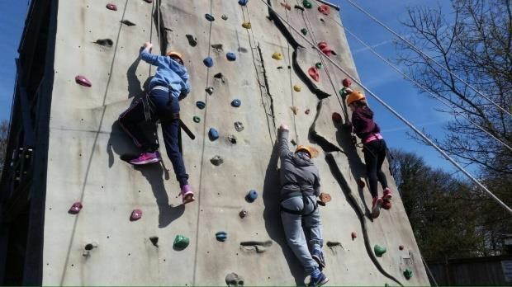
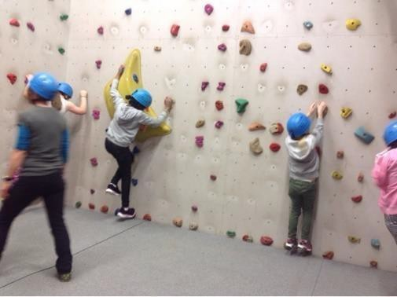
Archery!
Everyone will experience a morning/afternoon of archery
*You MUST wear a long sleeved top to take part in archery
Children with long hair will need to tie their hair back for this activity
Rock Climbing!
*Everyone will experiencea morning/afternoon of rock climbingand
indoorbouldering
  Children with long hair will need to tie their hair back for this activity
  It is recommended you wear long trousers/leggings for this activity

Slide 15
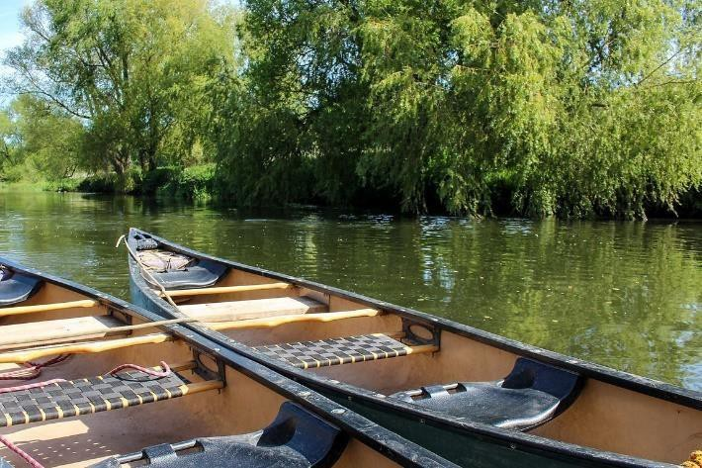
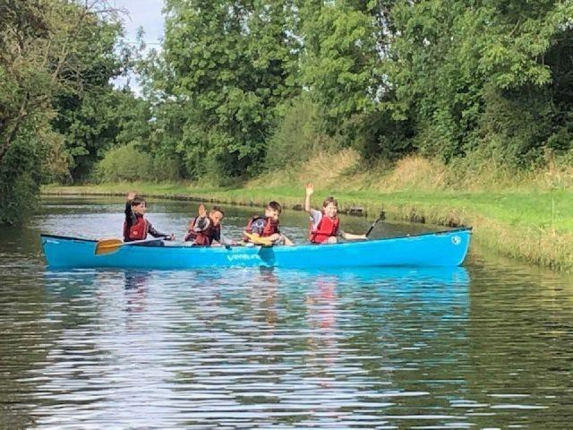
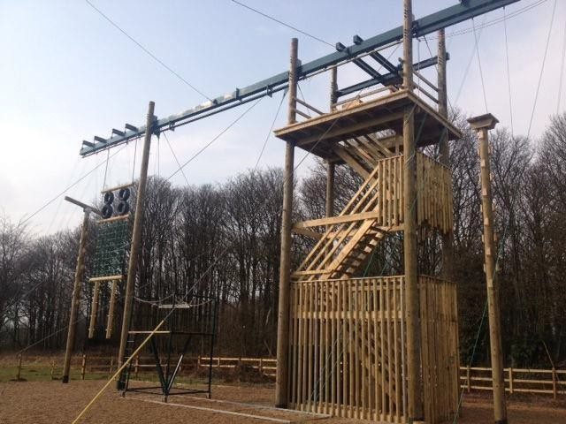
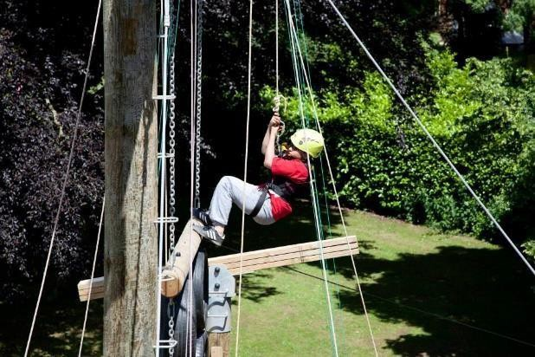
Canoeing and water games!
* Everyone will get to enjoy a morning/afternoon ofcanoeing
*It is recommended that old trainers which you don’t mind getting (very) wet are worn for this activity
Canoeing will take place on the very sheltered water of the Staffordshire andWorcester canal
Weak swimmers and non- swimmers can often still participate. However, if your child is a NON- SWIMMER, please highlight this on the medical consent form
All centre staff leading activities with water hazards are suitably qualified and experienced to do so,
having been specially trained
High ropes!
Perfect for the ‘GoApe’ fans!
Everyone will get a chance to scale the high ropes
and face the ‘Power Fan’ jump…
*It is recommended that you wear long trousers / leggings for this activity and tie long hair back

Slide 16
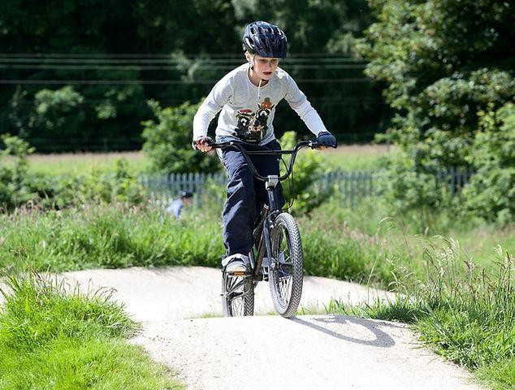
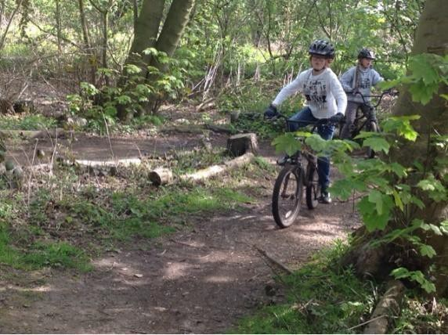
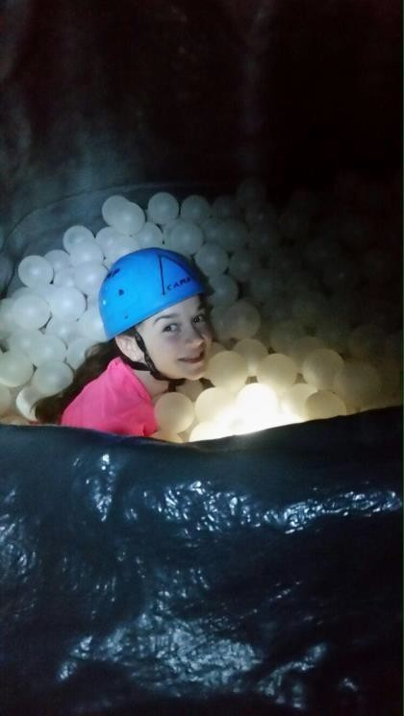
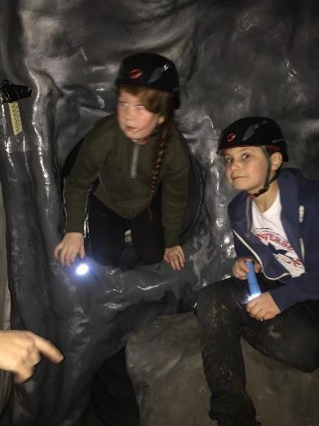
BMX-ing!
Each of you will get a half day of BMX biking on tracks and trails
Helmets and BMXing gloves will be provided by Laches Wood
*If your child is unable to ride a bike without stabilisers, please let a member of the school staff team know ahead of the residential visit
Caving!
Each group will have a go at caving inside the Labyrinth (an indoor caving system that creates an exciting atmosphere!)
Helmets and torches will be provided by Laches Wood

Slide 17
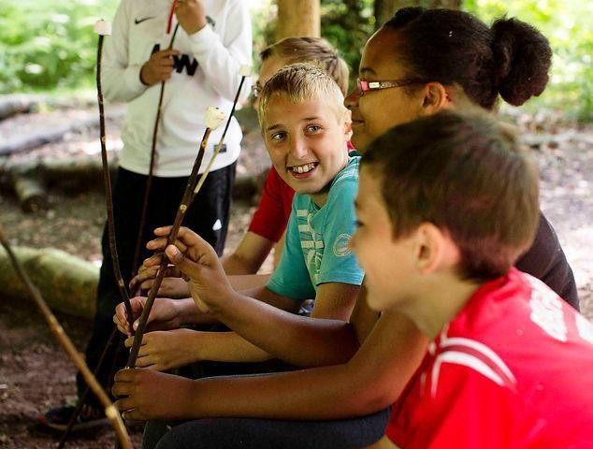
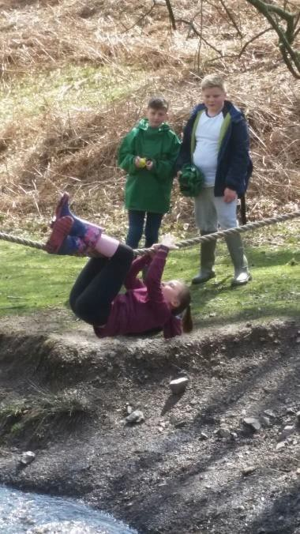
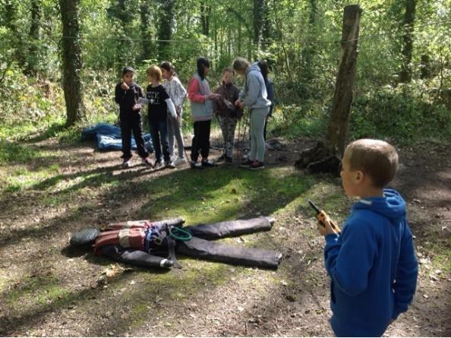
Search and Rescue!
This is an integrated, problem solving exercise involving the use of radios for communication, map skills and teamwork
Axe Throwing!
* Put your hand eye coordination skills to the test to see which team can hit the targets in this fun activity! Long sleeves required for this please.

Slide 18
Key things to remember!
Read through the menus your child brings home (or request via office email)
*Please let us know by if you have any ADDITIONALdietary requirements to that already known by school
Read through and complete the medical and consent forms your child brings home (or
request via office email)
Please return the medical form by Friday 3rd October 2025
*Read through the Behaviour Code of Conduct and ensure your child understands this.
Read through the kit list on the website.
This is such an exciting opportunity for your child to develop life skills and independence. Wave them off with a smile, enjoy a cup of tea or more and wait for them to return home full of the adventures of the week!

Slide 19
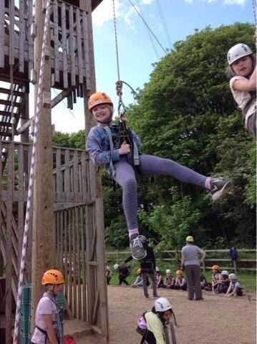
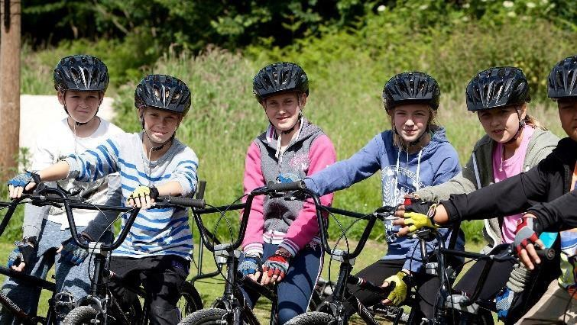
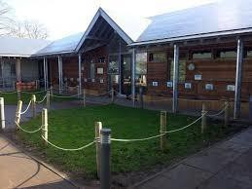
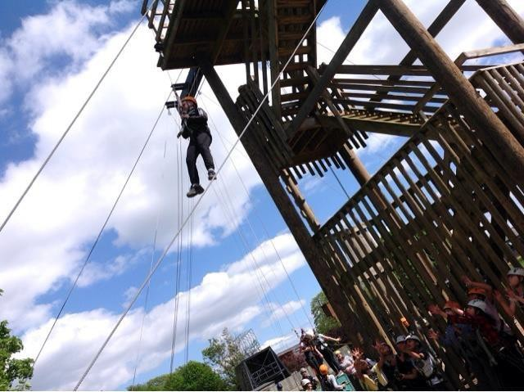
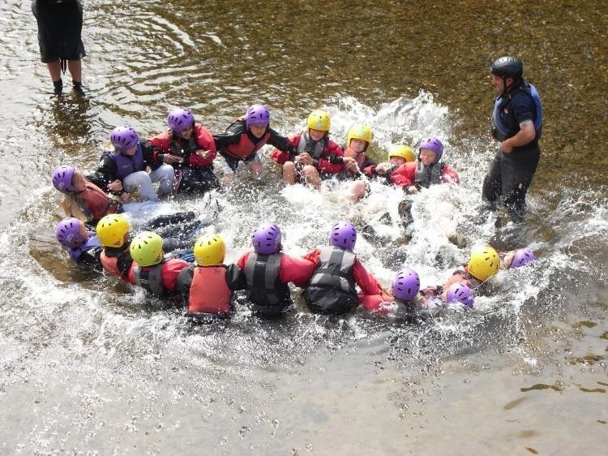
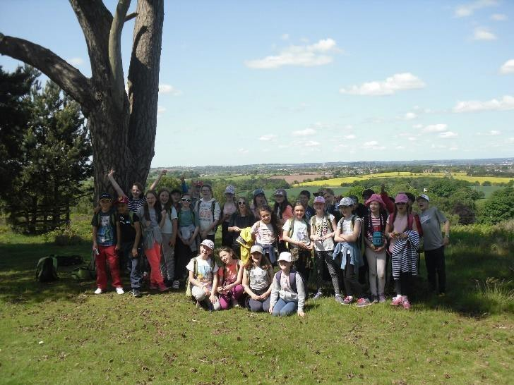
Have the best time!

